Slide 1
Foundation - Topic 2 – Using and Sharing Documents
Starter
Open up your Topic 2 Document from your My Documents – Introduction folder. Help others.
Username – 21SmithJ@croftonschool.co.uk
Password (You chose this last lesson and wrote it on the Topic 1 PowerPoint)

Slide 2
Mastery Statements Level 2 – 3
Mastery 2 (IT)
I can create and organise my folders with a little help.
I can use text and images to produce information.
I can receive feedback (what went well).
I can receive feedback (even better if).
I can make improvements to my work.
Mastery 3 (IT)
I can organise my folders and documents.
I can use text, images and other software to produce information on Office 365.
I will write what I improved on my leaflet.

Slide 3
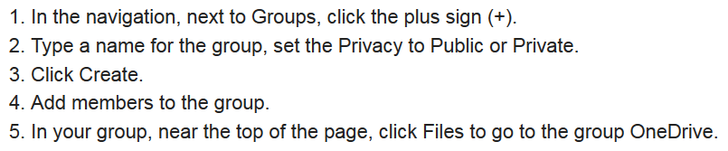
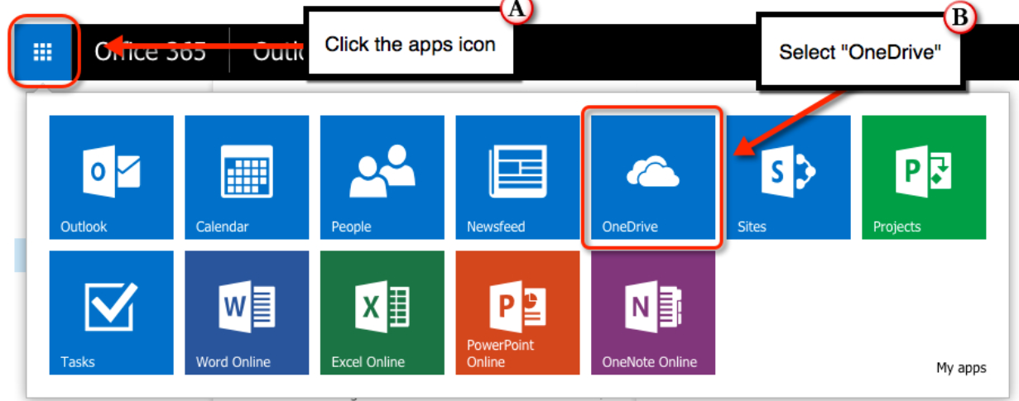
Foundation - Topic 2 – Using and sharing documents
?
Foundation:
Up to and including 3
What is your target grade 2 or 3?:
Today we are going to use and share documents using Office 365.

Slide 4
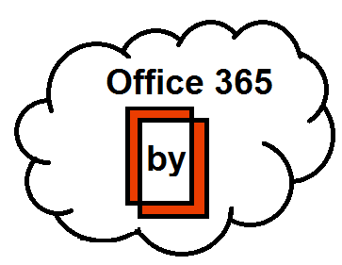
Topic 2 – Using and Sharing Documents
Task:
Using Office 365 create a shared document with at least one other member of the class.
Explain in your document the following:
What email is
How can you use your phone with Office 365 for school based information
How can you collaborate online
What do all the apps allow you to do?
You could make your own image using the images online?.

Slide 5
How have I done?
 | Self Ass Y/N
A
B
C
D
E
F
G
Mastery 2 (IT)
2(1) I have opened and saved a document with a little help.
2(2) I can explain the software I have used.
2(3) I have made my own image.
2(3&4) I have given information about Office 365.
2(5) I got 1 x www.
2(5) I got 2 x ebi’s.
2(5) I made improvements to my work.
Mastery 3 (IT)
3(1) My documents are organised and well named.
3(2) I have used text, images and other software to produce my information on Office 365.
3(3) I made improvements following feedback and wrote what I improved on my document.
3(3) I worked with someone having shared a document.
 | Self Ass Y/N
A
B
C
D

